Slide 1

Lake Erie Ecosystem Priority (LEEP): Scientific Findings and Policy Recommendations to Reduce Nutrient Loadings and Harmful Algal Blooms
- Report Overview -
Lake Erie LAMP Work Group
February 10, 2014
Tom Ridge Centre - Erie, PA
Notes:
The last time I attended a Work Group meeting was as a Conservation Authority staffer, so needless to say a lot has changed for me, and it gives me great pleasure to talk about the IJC’s LEEP activities.

Slide 2
Overview
IJC Role
Context and Origin of LEEP
Key Findings
Recommendations
Next Steps
Questions & Comments Welcome!
Notes:
I thought I’d keep things at a fairly high level, and will start with a few remarks on the role of the IJC, and then talk more about why the IJC established its Lake Erie priority, some of the reports key findings and recommendations. I’ll wrap up with a brief discussion of what comes next.
This is a pretty informal group, so please ask questions as we go along.

Slide 3
IJC Role
Boundary Waters Treaty Act (1909):
“It is further agreed that the waters herein defined as boundary waters and waters flowing across the boundary shall not be polluted on either side to the injury of health or property on the other”.
IJC established to prevent and resolve disputes related to shared waters
Notes:
To get started I wanted to remind you about the origins of the IJC, and so I include a quote from the 1909 Boundary Waters Treaty, which I think still holds just a little bit of inspiration over a century later as it speaks to binational cooperation on the management of transboundary waters.
Among other things, the Treaty established the IJC with a mandate to prevent and resolve disputes related to our shared waters.

Slide 4
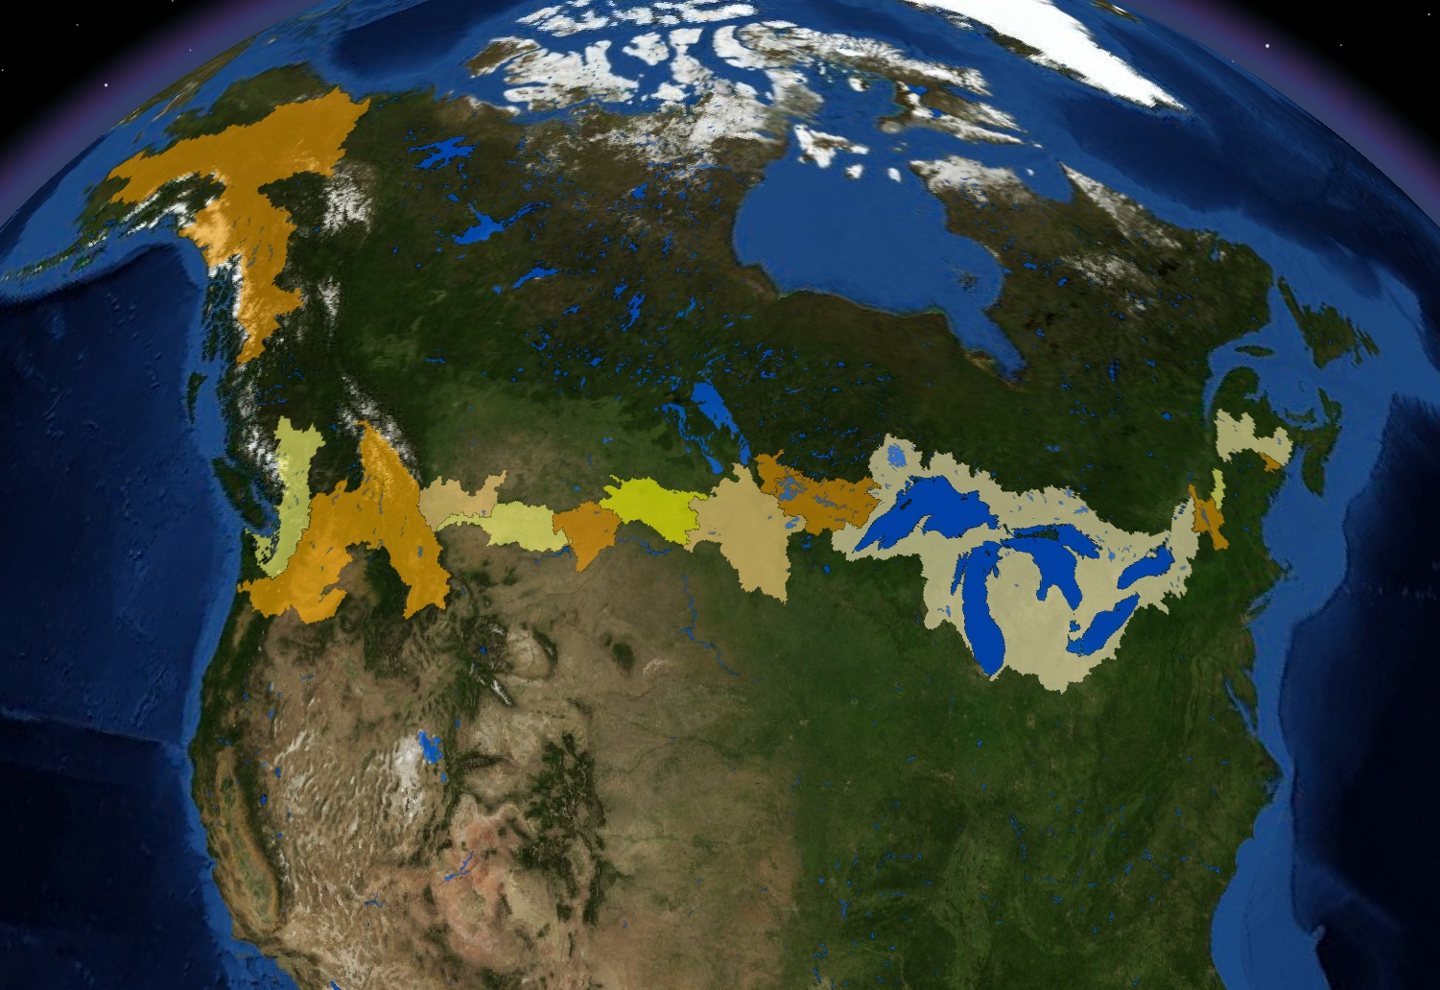
Notes:
Although the geographic scope of the IJC extends from coast to coast to coast, the GL occupy roughly 40% of that boundary and probably account for more than 40% of the overall activity of the IJC.

Slide 5
Great Lakes Water Quality Protocol of 2012
Role of Parties – development & implementation of plans, programs and related activities
Role of IJC – periodic assessments, provide advice, public outreach
  Article 7 – The International Joint Commission
  Article 8 – Commission Boards and Regional Office
Article 7(l) – “Providing to the Parties, at any time, special reports concerning the quality of the Waters of the Great Lakes”
Notes:
Although the IJC has a regulatory role in projects that alter the flows of levels of transboundary waters, including 3 in the GL, our primary role in the GL is described in the Great Lakes Water Quality Agreement.
Before I get to the IJC, I want to emphasize that the responsibility for the development and implementation of plans, programs, policies and related activities to address Lake Erie water quality rests with the governments of the United States and Canada, and the IJC respects that our role is not to implement.
Rather, our role is described primarily in Articles 7 & 8 of the Agreement, and can be summarized into three main themes:
First, tendering advice and recommendations to the Parties related to water quality. While a primary focus is on science advice, the social, economic and environmental aspects of current and emerging issues are all included.
Second, to periodically assess the progress of the governments towards the general and specific objectives of the Agreement, including the programs and measures described in the Annexes
Third, to consult with the public about issues related to GL water quality, including options for restoring and protecting those waters.
The IJC has three Boards that advise the Commission, including the policy-oriented Water Quality Board, the science, research and monitoring oriented Science Advisory Board, and the human health-oriented Health Professionals Advisory Board.
I would note that we offer our LEEP report to the governments in relation to Article 7(l) of the Agreement.

Slide 6
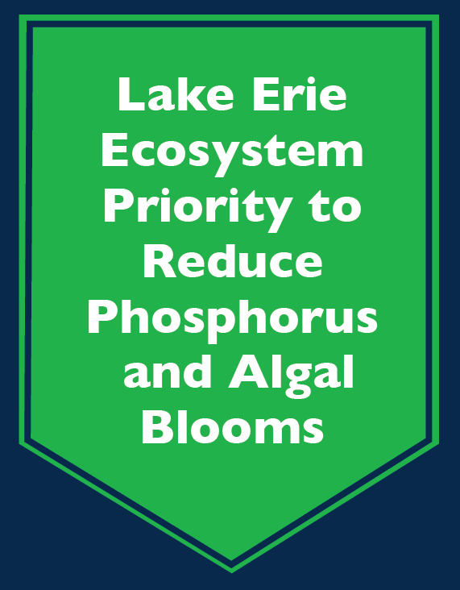
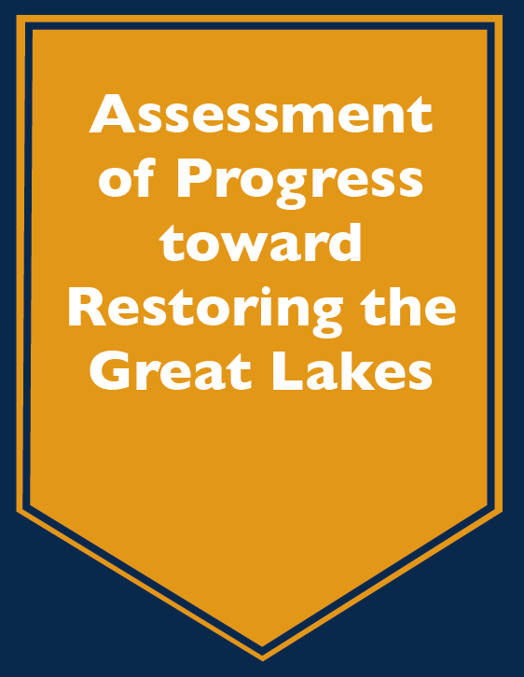
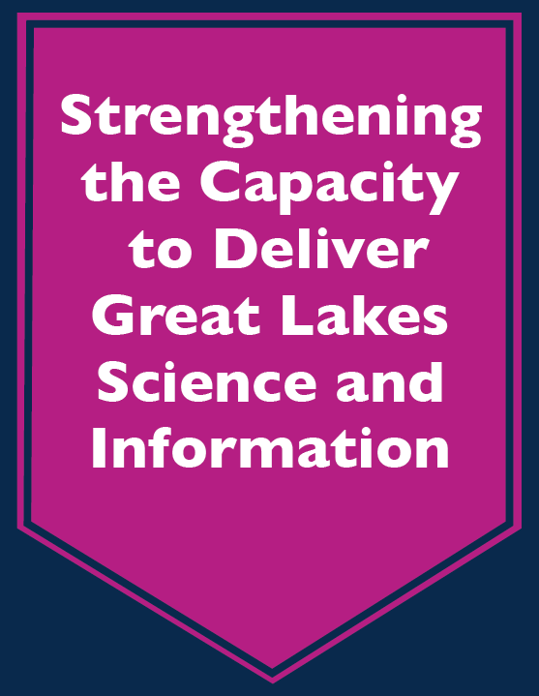
IJC Priorities – 2012-15
Notes:
As most of you know, the IJC has long completed in depth investigations through a series of Priority Cycles. These cycles used to renewed biennially, but under the 2012 Protocol will be triennial cycles. For the current triennial Priority Cycle we have three priorities:
The first is our LEEP, the second focuses on the development of a related set of ecological, human health and program effectiveness indicators, and the third involves an assessment of the capacity of science and geospatial information programs to achieve the objectives of the Agreement.

Slide 7
LEEP Objective
To provide science and policy advice to governments that would reduce nutrient loads and harmful algal blooms
(but not all basins are created, or treated, equally…)
Notes:
So the objective of LEEP is to provide science and policy advice to the governments in relation to nutrient loads and nuisance and harmful algal blooms.
I want to mention right off the bat that the report focuses on the western and central basis, where large majority of nutrient loadings occur, and where the effect of excess nutrients are most pronounced.
For the 2003-11 period of record, the western basin received 64% of the average loads, while the central received 26% and the eastern basin received 11%.

Slide 8
Complementarity
Lake Erie LAMP’s Binational Nutrient Management Strategy
Lake Erie Commission’s Ohio Phosphorus Task Force I and II reports
U.S. EPA’s Great Lakes Restoration Initiative
Environment Canada’s Great Lakes Nutrients Initiative
…and others
The LAMP and LEMN have a crucial role to play
Notes:
Obviously the IJC’s effort is one of just several recent or ongoing efforts related to the nutrient threat in Lake Erie. It goes without saying that the LE LAMP and the Millennium Network will have a central role to play in framing and enabling solutions to the nutrient problem in Lake Erie, among other issues.

Slide 9
LEEP Process
Spring, 2012 - Science Advisory Board – Taking Action on Lake Erie (TAcLE) Work Group established
Fall, 2012 – Consultations on IJC approach
Winter, 2012/13 – Preparation of 7 Review Papers e.g., external loading, load-response curves
February, 2013 – Expert Workshop
August, 2013 – Draft LEEP Report Release
September – October, 2013 – Consultations
February 27, 2014 (tentative) – LEEP Report Release
Notes:
So in terms of the study process, it started roughly 2 years ago with the formation of a TAcLE WG by the IJC’s SAB. It was co-chaired by Sue Watson from EC and Dave Carpenter from the University of Albany.
***TAcLE prepared the science synthesis that is the main focus of the LEEP report***
As you can see from this slide, there were consultations on the proposed IJC approach for the study, after which the TAcLE Work Group prepared several related review papers on a variety of nutrient related topics. LEEP work focused primarily on scientific priorities, although it included socio-economic and regulatory themes as part of a comprehensive approach.
The science papers were discussed at an expert workshop held a year ago in Windsor, and then IJC staff used the final TAcLE report and the review papers to develop a draft LEEP report which was released for comments in late August of last year.
We heard from hundreds of residents and organizations during 7 open houses, and over 60 written submissions via our website.
We are currently in the throes of finalizing a revised report, which we hope to release by the end of this month.

Slide 10
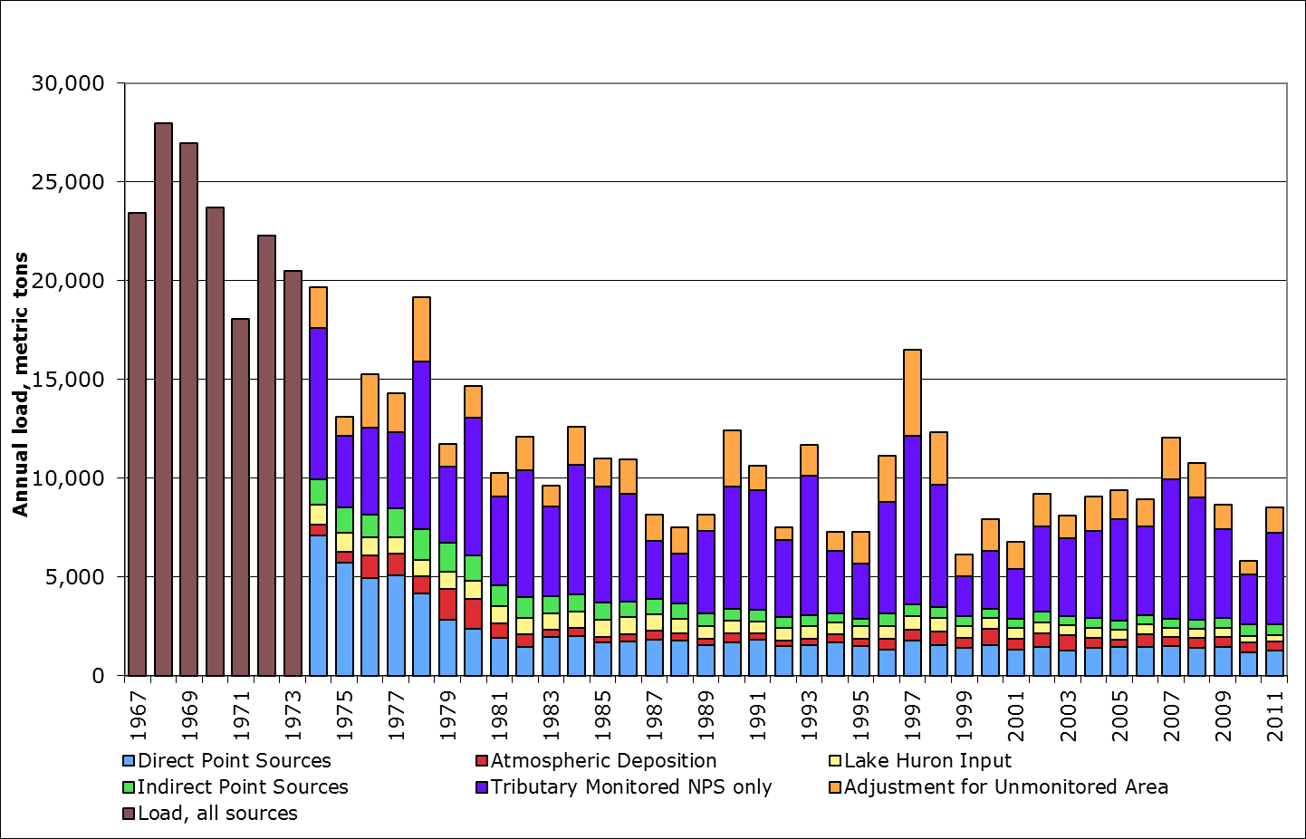
Estimated Annual External TP Loads to Lake Erie (MT)
Source: Dolan
Notes:
So as you can imagine the report acknowledges the tremendous success of overall reductions in external loadings to Lake Erie, and examines the growing proportion of total loads attributable to non-point sources, shown here in royal blue and orange.

Slide 11
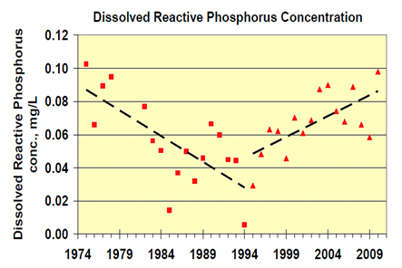
Source: Heidelberg University, unpublished data
Notes:
It also spends some time examining the trends of declining TP and DRP concentrations in those non-point source loads through to the mid-1990s, followed more recently by an alarming increase in DRP concentrations and loads in non-point source runoff since that time, even as TP has remained steady for the most part.

Slide 12
Key Findings – Phosphorus Loading
2011 sources:
>50% monitored agricultural/rural NPS
~ 16% unmonitored NPS
~ 16% point sources
4-6% from Lake Huron
4-6% from atmospheric
Agricultural operations are the major source of NPS loads
84% row crops, 16% manure (Ohio)
Increasing influence of DRP vs. TP
At least half of annual load from March 1 – June 30
  Priority watersheds e.g., Maumee delivers ~50% of WB load in high concentrations
Notes:
So for the next few slides I’ll summarize some of the major findings of the report, which again represent a synthesis of available science.
In relation to loads, roughly 2/3 of P is coming from non-point sources, a majority of these from agricultural sources. Point sources have been reduced dramatically over the years due to STP improvements and changes to detergent regulations, and currently comprise roughly 16% of total loadings. Smaller proportions come from the upper lakes and atmospheric sources, with some uncertainly associated with upper lake loadings which I’ll mention again later.
Based on Ohio data, agricultural sources a predominantly from row crop agriculture and commercial fertilizers, with a smaller proportion from livestock sources of P.
The proportion of DRP reaching the lake has increased dramatically, and over half of annual loads reach the lake during the spring season when flows are highest.
TAcLE also concluded that a focus of LE restoration should include the Maumee River, which delivers ~50% of WB load in high concentrations. We can thank Heidelberg College’s decades long monitoring of Ohio tributaries for informing the analysis.

Slide 13
Key Findings – Effects
West basin HABs driven by high concentration loads from (primarily) Maumee R. and other Ohio tributaries
Central basin hypoxia driven by west and central basin loads including low concentration, high load Detroit River
East basin benthic algae influenced by local sources?
Fish communities affected e.g., oxy-thermal squeeze
Notes:
In terms of effects of P loading to LE, TAcLE concluded that WB HABs are driven by high concentration loads from primarily the Maumee River and other Ohio tributaries. Decades long monitoring by Heidelberg College points to a number of Ohio tributaries as contributing a majority of the load, especially the Maumee.
CB hypoxia is driven by WB and CB loads including the low concentration, high load Detroit River, which delivers almost half of the WB load in 95% of its inflow.
There is less information available on E basin cladophora, but available evidence suggests they are influenced by local sources
TAcLE found that phosphorus loading together with future climatic conditions could alter Lake Erie’s fish community. In the central basin, fish will be forced into suboptimal habitats for part of the year to avoid the oxygen deficient hypolimnion and the warmer epilimnion. Throughout much of the lake, cold-water species and species sensitive to low oxygen and reduced water clarity would be expected to decline, while species more tolerant to warm water likely will thrive.

Slide 14
Key Findings - Other
Confounding influence of climate change
Limited data on economic effects and human health effects
Limited understanding of the effectiveness of BMPs in removing DRP
Uneven regulation and policy across Lake Erie jurisdictions
Notes:
Other finding addressed in the report include the confounding influence of climate change, where in addition to fish impacts, precipitation patterns are likely to be characterized by less frequent, but more intense, storms. Such intense events are likely to lead to high nutrient runoff from agricultural and urban lands, increased overall nutrient loads to Lake Erie, and increased severity and frequency of algal blooms.
Climate change could exacerbate the magnitude, duration and frequency of hypoxia in Lake Erie. Warmer future conditions are expected to facilitate an earlier and longer period of stratification during summer, causing algal growth and hypoxic conditions to begin sooner and persist over an extended time period.
The LEEP study found that there are limited data on economic and human health effects of HABs, and that our understanding of the effectiveness of BMPs in removing DRP needs to improve.
An investigation of regulations governing nutrient application and other issues found, as you would expect, a lot of unevenness across the basin.

Slide 15
Recommendations
Report includes 16 Recommendations addressing:
Loading Targets
Agricultural Sources
Urban Sources
Monitoring and Research
Notes:
So our report will include roughly 16 recommendations, which link to the science and policy findings of the report. Many of these will be familiar and are not unique to our report, since our report presents a synthesis of science and policy from a binational perspective.

Slide 16
Recommendations – Loading Targets
Using Response Curves:
To reduce WB cyanobacterial index to 1 (no/mild bloom) based on 2007-12 average, a 37% reduction in TP and 41% reduction in DRP will be required from Maumee River and WB tributaries (WB target load of 3,200MT)
To reduce CB hypoxia to 2,000km² and 10 days based on 2003-11 average, a 46% reduction in TP and 78% reduction in DRP will be required from WB and CB tributaries (WB and CB target load of 4,300MT)
Solving one problem will not necessarily solve the other
Notes:
Using load-response curves developed by members of the TAcLE team, targets for reductions in loadings over recent average loads for both WB HABs and CB hypoxia are suggested. Because these suggested targets used the same models as the OH P Task Force, the recommended reductions are the same as those reported in their recent Phase 2 report.
Using models, you can see from this slide that reducing WB HABs to a no/mild bloom condition will require a 40% reduction in both TP and DRP from WB tribs. Note that the observed loads for the period of record hovered around the 11,00MT per year interim target in the GLWQA.
For CB hypoxia, larger reductions in TP and especially DRP will be required for WB and CB tributaries. DRP reductions tend to be higher due to the steady increases in DRP as a proportion of TP over the period of record.
Because these suggested load reductions are in relation to 2 basins and the issues of HABs and hypoxia, solving one problem will not necessarily solve the other.

Slide 17
Observed and Modeled Response Curve Relationship between TP Load and the Cyanobacterial Index (CI) for the Maumee River
(plotted in relation to the spring (March-June) TP load, in metric tonnes [MT])
Source: modified from Stumpf et al. (2012)

Slide 18
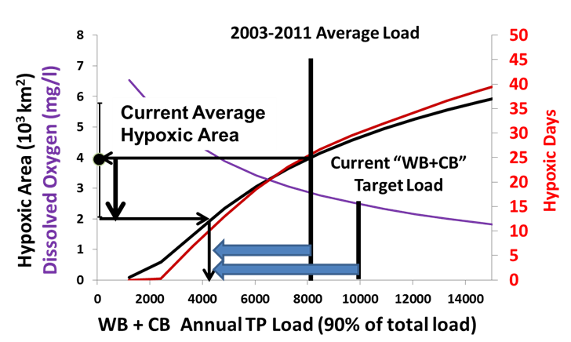
Response Curve Relationships between (A) Annual TP Loads and (B) Annual DRP Loads for the Western and Central Basins of Lake Erie and Hypoxic Area and Number of Hypoxic Days
(Hypoxia area in km²)
Source: Modified from Rucinski et al., 2010

Slide 19
Recommendations – Ag/NPS
Incentive-based programs:
Expand focus to include DRP and TP
Focus on critical March-June period
Focus on priority watersheds
Increase scale and intensity of projects
Regulatory interventions:
Mandatory certification standards for applicators
Link crop/production insurance with conservation performance
Ban applications on frozen ground
Mandatory septic system inspections
Notes:
Other recommendations include:
Expanding the focus of BMP programs to include both TP and DRP. This acknowledges that TP reductions due to soil erosion reduction have multiple benefits, although they don’t address DRP, while also expanding a focus of BMPs to reducing P applications, slowing water movement, and trapping water and P at the field or farm scale.
The March-June period is critical, and reducing DRP runoff to the extent possible is needed
Modeling has shown that there are a number of priority watersheds where greater attention should be focused. Most of the US watersheds are in Ohio and include the Maumee, Sandusky, Cuyahoga, Grand, Raisin. Priority Canadian watersheds include the Thames and the east basin’s Grand, with others that no doubt will be illuminated through GLNI.
The scale and intensity of BMP projects that have been proved to reduce nutrient export needs to increase, particularly in priority watersheds and in combination.
We’ve also recommended a number of regulatory interventions…

Slide 20
Recommendations - Urban
Improve adoption of green infrastructure through a variety of mechanisms
Prohibit the sale and use of P fertilizers for lawn care, with some exceptions
Notes:
For urban locations, we are recommending increased use of green infrastructure through voluntary mechanisms and policy reform.
For those states and Ontario where fertilizers containing P for lawn care are not banned, we are recommending they be banned. Although since Scott’s and other fertilizers are now P free there are options for the consumer.

Slide 21
Recommendations – Research and Monitoring
Monitoring
Enhanced tributary monitoring including wet weather
Detroit River outlet continuous monitoring
Effectiveness of rural and urban BMPs
Research
Improved modelling
Open lake dredged material disposal
Influence of climate change on fish communities
Improved data management through greater coordination and monitoring
Notes:
And many of our recommendations on monitoring and research will also be familiar.
Improved tributary monitoring, particularly for wet weather events is needed.
We need a better understanding of Detroit River loads because there has not been adequate monitoring between the L Huron outlet and DR outlet, and the results that are available tell varying stories.
The effectiveness of BMPs in removing DRP needs to improve
On the research side, multiple models for LE nutrient effects are needed.
There needs to be an improved understanding of the effect of dredge spoil’s impacts on HABs in the WB, and the Corps has some work underway.
We need to improve our understanding of the effects of climate change on fish communities.

Slide 22
Next Steps
Public Report Release (tentative) on February 27, 2014
  Submission to governments in advance
  Legislative and Agency briefings
LEEP Phase 2 (2014, 2015):
  Human health effects
  Modeling tools
  Economic impacts
Notes:
We are currently finalizing our LEEP report, and hope to have Commissioner approval next week so it can go to layout and printing.
A tentative date of February 27 has been set for public release, and our intent is to have it to the governments prior to public release. There will be legislative and agency briefings on the report immediately before the public release, also.
For the balance of the triennial Priority Cycle we plan to further investigate the effects of LE HABs on human health through exposures from drinking water and recreational activities, and
Hold a modeling workshop to improve the application of water quality models in addressing excessive nutrient loading in Lake Erie and its watershed and
Develop a more complete understanding of the economic impacts of Lake Erie eutrophication and the economic benefits of addressing the nutrient threat.

Slide 23
Thanks!
For draft LEEP report visit www.ijc.org
(final report will be posted February 27, 2014 (tentative))
childm@windsor.ijc.org
Notes:
Thanks. Are there any questions?

