Slide 1
Lake-scale planning for management, conservation and restoration
Objective:
Bring together researchers, managers, NGO representatives and other interested parties to develop a data-driven approach to help establish spatially explicit management priorities at the scale of an individual Great Lake.
Support lake-scale management, including the LAMPs

Slide 2
Outputs and outcomes
Assembly of datasets and maps for one Great Lake, providing spatially explicit knowledge of environmental stressors, ecosystem services, and existing management actions and capacity;
A site-based prioritization framework that identifies highest priority management needs and the necessary strategies to implement effective management;
Demonstration of a data-driven approach to lake-scale management that can support existing LAMPs;
Progress towards data sharing and data integration in the Great Lakes basin.

Slide 3
Rationale
The increasing availability of large data sets and GIS mapping tools offers the potential to develop data-intensive approaches to help identify specific areas and targets for management, conservation and restoration
Because each Great Lake is best viewed as a distinct socio-ecological system, differing in key ecosystem characteristics and the suite of environmental stressors that it faces, lake-scale planning for management, conservation and restoration is likely to meet with the greatest success

Slide 4
Some Datasets and GIS Projects
GLEAM (Great Lakes Environmental Assessment and Mapping)
Mapped multiple environmental stressors over surface of five Great Lakes, currently mapping ecosystems services
GLEI (Great Lakes Environmental Indicators)
Mapped multiple environmental stressors throughout GL basin, linking stressors to lake condition for indicator development
TNC BCS (Nature Conservancy Biodiversity Conservation Strategy)
Extensive stakeholder engagement in identifying biodiversity targets for each lake and conservation strategies for their protection
GLAHF (Great Lakes Aquatic Habitat Framework)
an aquatic habitat database and classification framework integrating key habitat components with a focus on coastal and nearshore systems.

Slide 5
Brief Introduction to GLEAM
A research team of 22 individuals (U.S. and Canada, academic and NGO) mapped 34 environmental stressors across the Great Lakes
Using formal expert elicitation, the relative weight of each stressor by habitat and lake was determined
Individual stressors and their cumulative sum were mapped at the 1 km2 scale, providing insight into the spatial distribution of human impacts
From 8-31 stressors were present at individual pixels
Results are available on our website with an interactive map and documentation
Greatlakesmapping.org

Slide 6
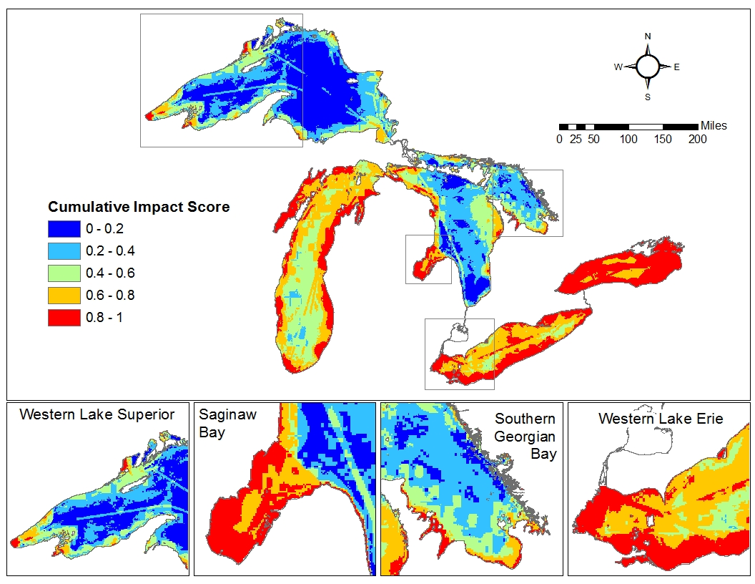
Cumulative Stress
Based on 34 stressors representing 7 themes: land runoff, contaminants, fishing pressure, invasive species, coastal development, aquatic habitat degradation and climate change
Relative scaling:
highest 20% = red,
lowest 20% = blue

Slide 7
Approach - 1
Begin with one Great Lake – Lake Erie?
Enlist others
LAMPs, fishery managers, LEMN, state agencies and OMNR, ……
Establish an advisory group
enough breadth to represent key management entities and problem areas
small enough to engage seriously on a continuing basis

Slide 8
Approach - 2
Select one lake and identify key partners, datasets, and an advisory team of managers and practitioners. Complete preliminary assessment.
Convene workshop 1 with advisory group to clarify needs, approaches, and outputs; adjust further plans to address manager priorities.
Proceed with data assembly, analysis and mapping to identify initial candidate sites for management, protection and restoration. Consult advisory team as needed.
Convene workshop 2 to present results of data analyses to advisory group to compare with managers’ perspective. Use formal elicitation methods of expert judgment to assess importance of identified stressors and services as well as management feasibility to mitigate particular environmental threats.
Incorporate expert judgment and prepare a technical guidance document that identifies highest priority management needs and strategies.
Convene workshop 3 for final vetting document. Revise as needed.

Slide 9
Timeline
Begin dataset identification and formation of advisory team
March-May 2014
Workshop 1 – refine objectives, identify additional datasets
Early summer 2014
Development of datasets, maps, analyses
July 2014- Feb 2015
Workshop 2 – critique results, obtain manager weightings thru elicitation
March 2015
Refine outputs based on workshop 2
March-June 2015
Workshop 3 – final vetting and revisions
June-Aug 2015. Final products completed Aug 15, 2015

Slide 10
What we would like from you today.…
Does this sound like an idea worth pursuing?
Can you help us identify datasets, advisory team members?
Perhaps some of you?
Can you help us refine the approach?
An expressed willingness of the Lake Erie LAMP to work with us, and interest in the outcomes, would greatly increase our credibility with those we seek to engage.
Thank you for listening!

